Slide 1
AWS CloudTrail Alerting
SYS-360

Slide 2
AWS CloudTrail
AWS CloudTrail is an AWS service that helps you enable governance, compliance, and operational and risk auditing of your AWS account.
Actions taken by a user, role, or an AWS service are recorded as events in CloudTrail.
Events include actions taken in the AWS Management Console, AWS Command Line Interface, and AWS SDKs and APIs.
Basically, logging for AWS console actions - not for the instances you have running in AWS

Slide 3
AWS CloudTrail - Supporting Services
CloudWatch
Log collections and viewer
AWS SNS
Simple Notification Service
CloudFormation
Provisioning Service
EventBridge
Automate actions based on AWS events
Athena
S3 Query Service

Slide 4
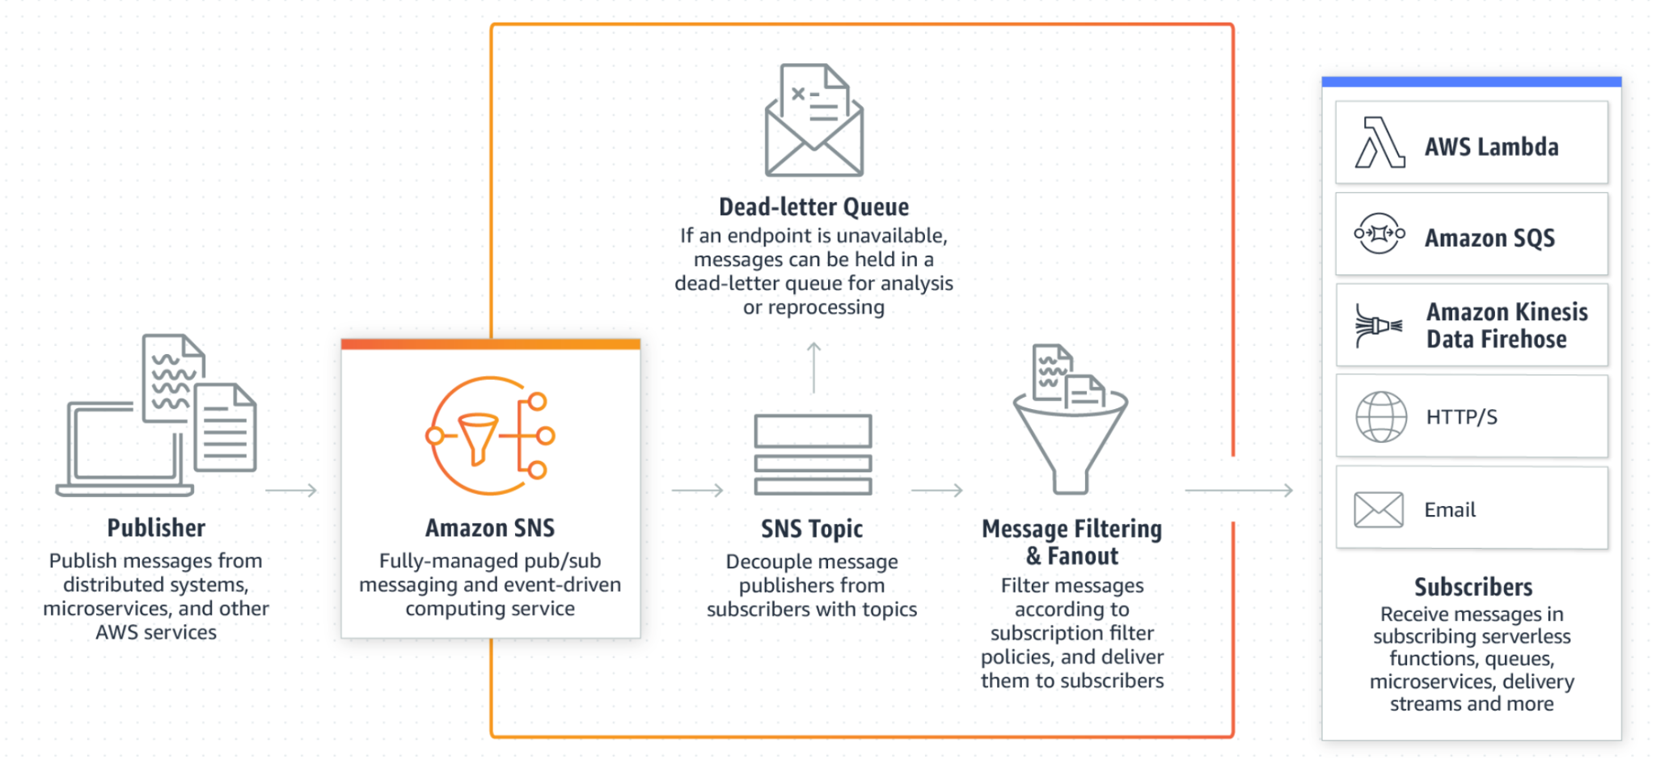
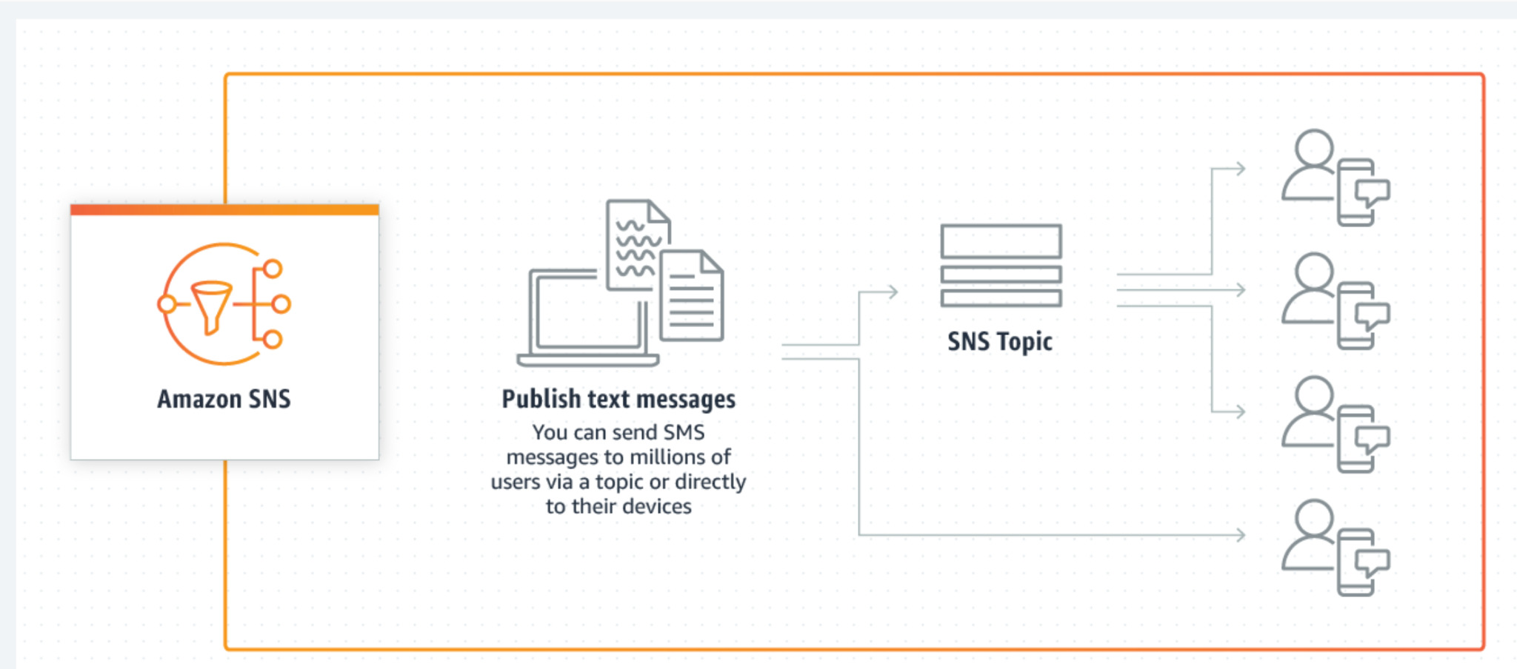
AWS SNS
Amazon Simple Notification Service (Amazon SNS) is a fully managed messaging service for both application-to-application (A2A) and application-to-person (A2P) communication.

Slide 5
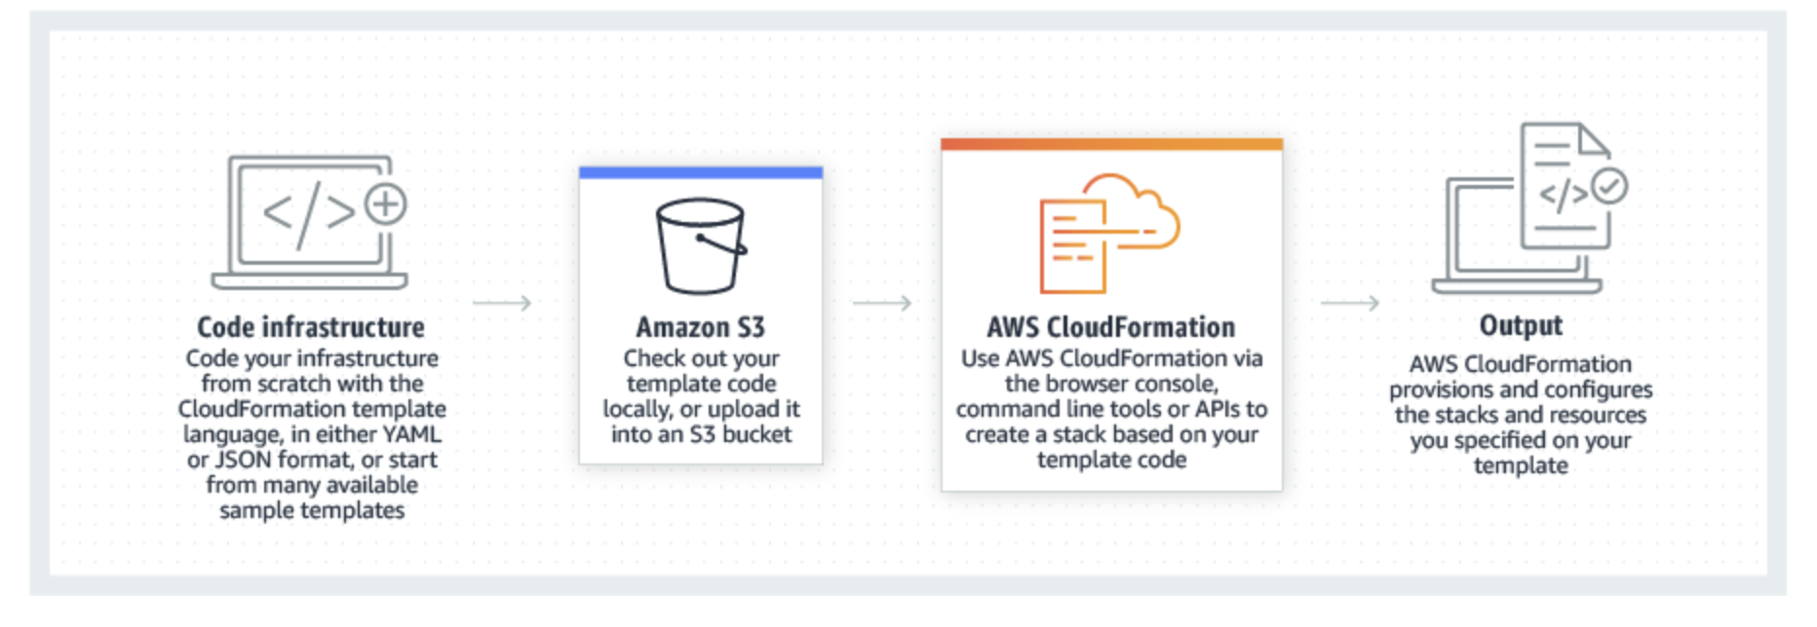
AWS CloudFormation
Infrastructure as Code (IAC)
Automate and Deploy AWS Resources based on Templates (JSON/YAML)

Slide 6
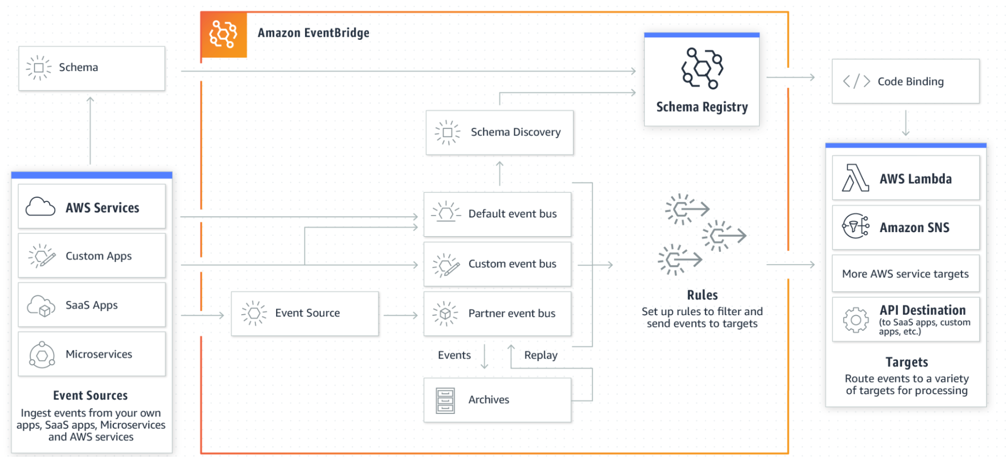
EventBridge
Formerly CloudWatch Events
EventBridge connects applications using events.
An event is a signal that a system’s state has changed, such as a change in the status of a customer support ticket.

Slide 7
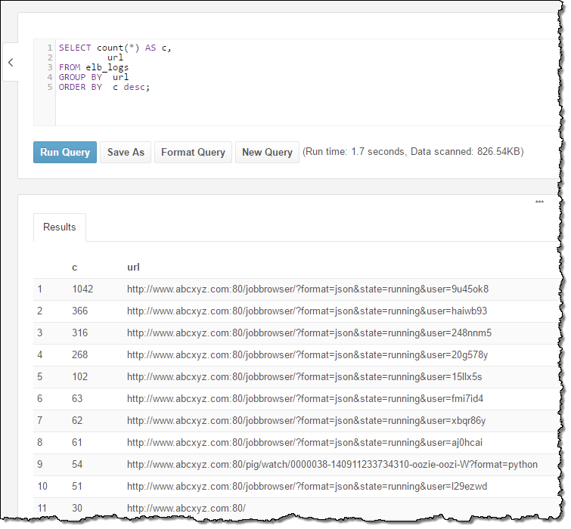
Athena
Amazon Athena is an interactive query service
makes it easy to analyze data in Amazon S3 using standard SQL.
is serverless, so there is no infrastructure to manage, and you pay only for the queries that you run.

Slide 8
Today’s Second Lab
Setup CloudTrail for Alerts
Use CloudFormation Template (provided) to provision:
CloudWatch Alarms
SNS “Topic”
Create EventBridge rules to send e-mails via SNS for certain CloudTrail events
Use CloudWatch Dashboards to review events
Use Athena to query CloudTrail Logs

